Slide 1
Chapter 17: Am I Really Just Average?
By Group 2:
Nidhishree Sanam
Shwetha Reddy Reddymalli
Sai Gangadhar Veeramreddy
Sai Manoj Kalasani
Sravani Ravulaparthi

Slide 2
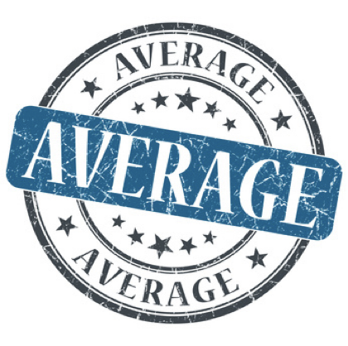
Story Recap
Sales rep’s performance review with the manager at Taco Bell.
Kerry’s behavior in the story.
Lesley’s performance review on a two-year assignment as a field sales rep.
Lesley’s behavior in the story.
Thoughts on the manager’s feedback on Lesley’s performance.

Slide 3
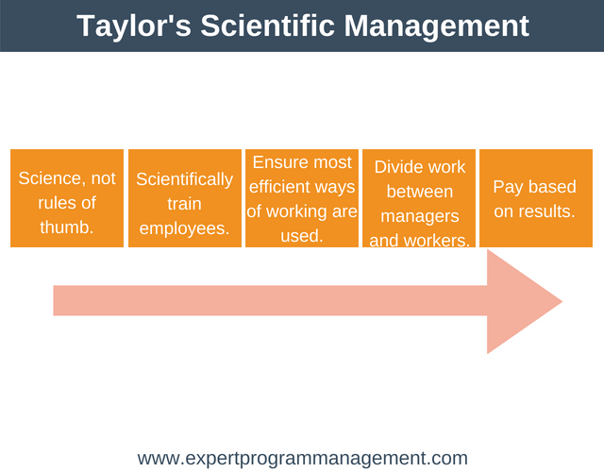
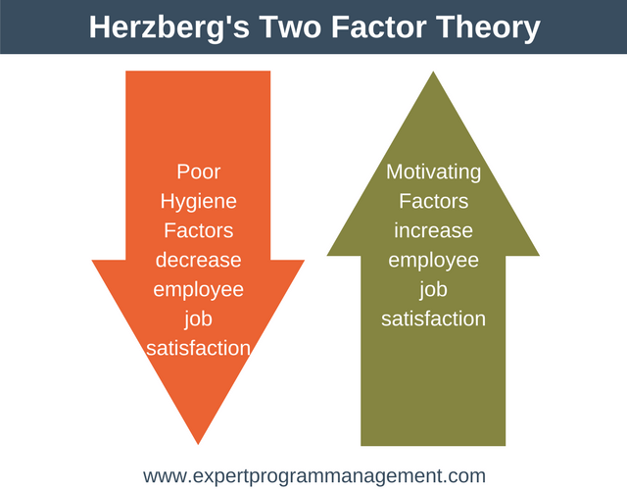
Motivation Theory
Taylor’s scientific management:
Taylor believed that all workers were motivated by money, so he promoted the idea of "a fair day's pay for a fair day's work."
Herzberg’s two-factor theory:
Hygiene Factor
Motivator Factor

Slide 4

Additional Research
Employee motivation is one of the critical factors for any company.
Successful companies make it a priority to ensure that employees are motivated and engaged in their work.
In amazon,employees are motivated by monetary incentives in addition to that other motivational factors like Interesting projects, work environment, learning opportunities, career growth opportunities, and of course money — all of them play a huge role.

Slide 5
References:
https://medium.com/@objoutlook/how-amazon-uses-money-to-motivate-employees-8e059f5a9698
https://smallbusiness.chron.com/herzberg-taylors-theories-motivation-704.html
The ropes to skip and the ropes to know_ studies in organizational theory and behavior-Chicago Business Press.pdf

Slide 6


